Slide 1
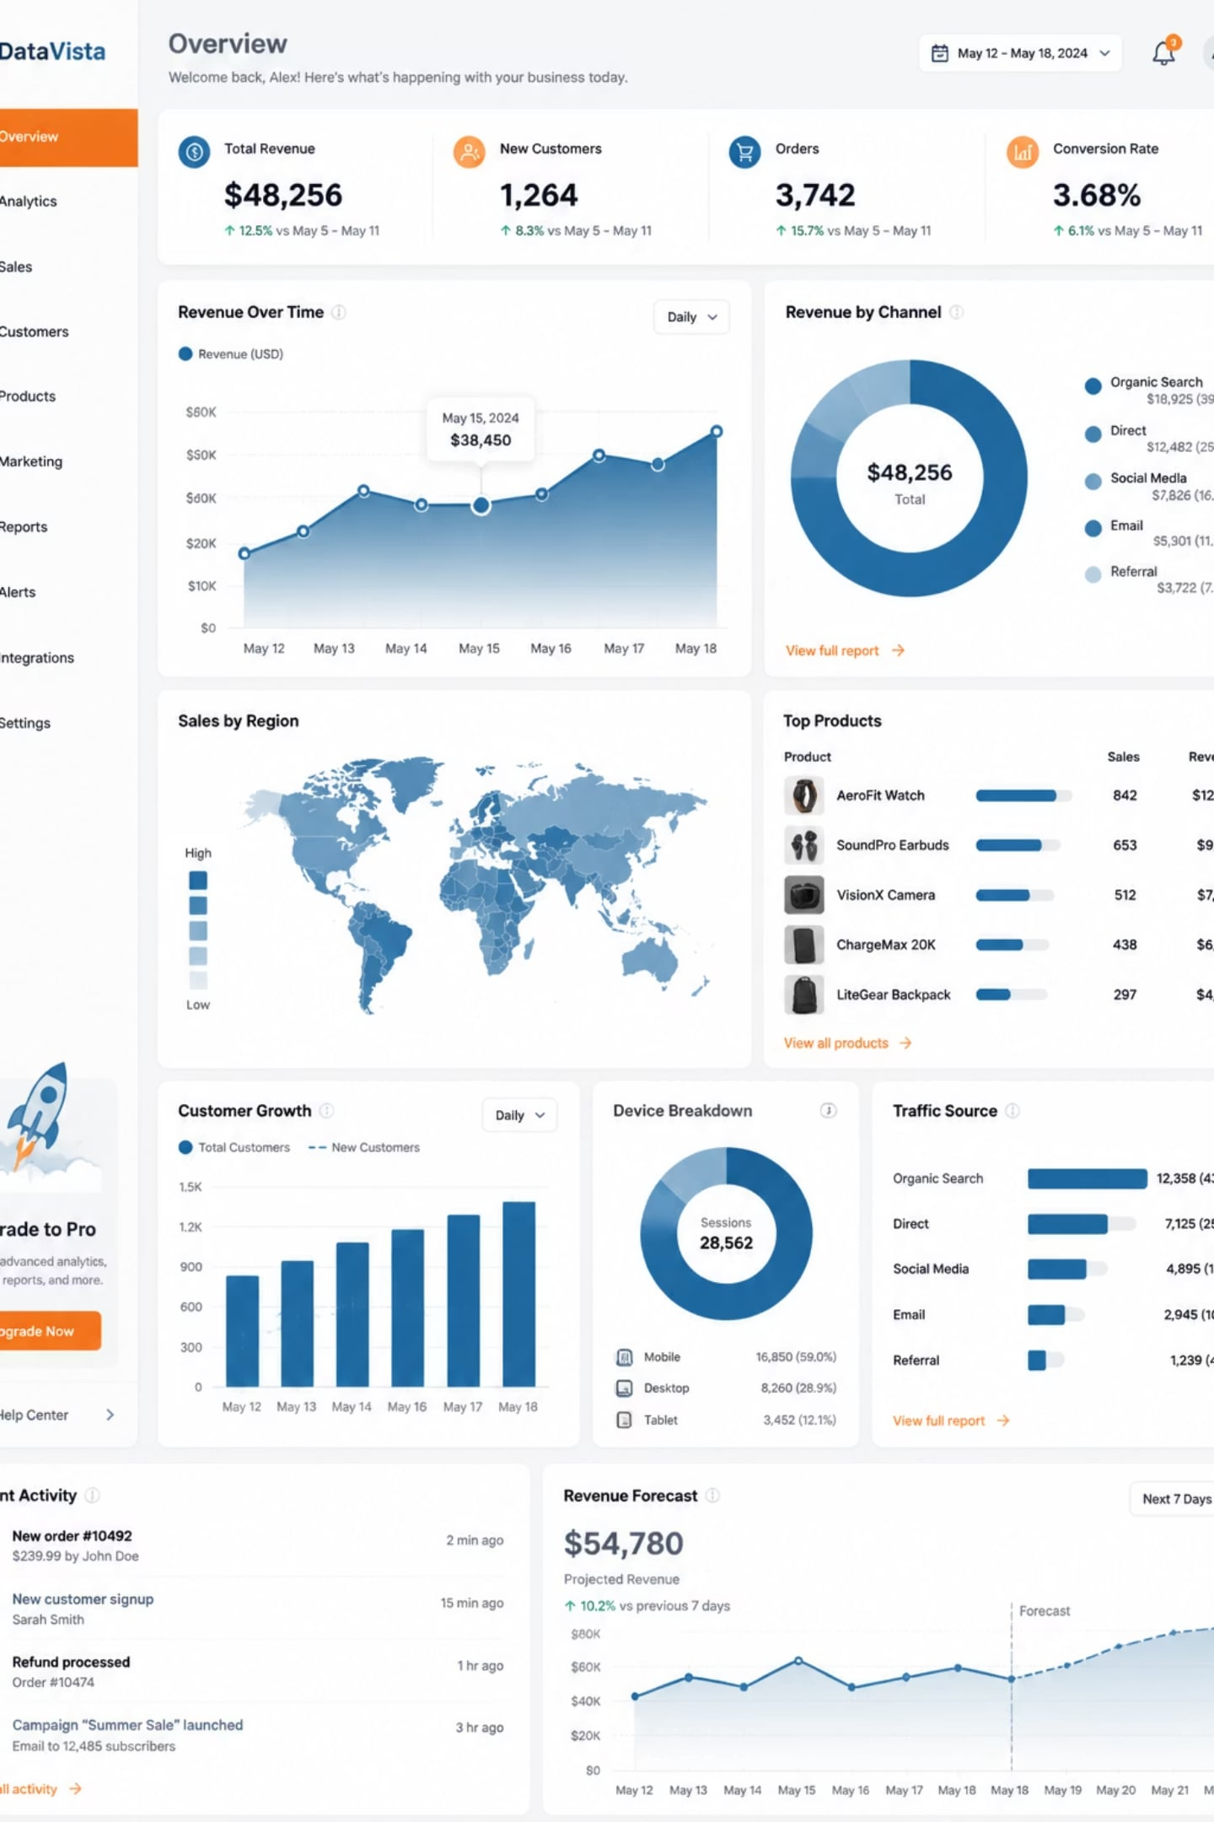
Supportlytics
Data-Driven IT Support Optimization
Milestone 2 Presentation · Modules 3 & 4 · Customer Support Tickets Dataset · 200,000 Records · 50 Features

Slide 2

Milestone Overview
Modules Completed
Feature Engineering
Module 3 – Exploratory Visualization
Feature
Description
Ticket Type, Category & Priority Distribution
Queue & Cluster Distribution
Queue
Support team assignment
Module 4 – Similarity & Clustering
Cluster_ID
Machine learning cluster
TF-IDF Text Vectorization
MiniBatch K-Means Clustering
Similarity Score & Cluster Performance Analysis
Cluster_Name
Business cluster label
Similarity_Score
Cosine similarity
Similarity_Level
High / Medium / Low

Slide 3
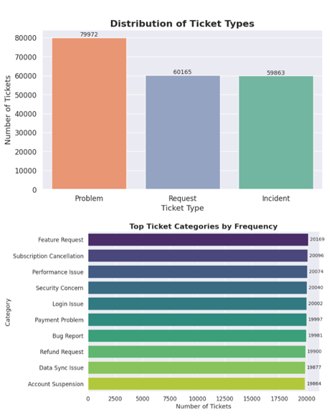
Exploratory Visualization I
Ticket Type Distribution
Problem tickets represent the largest share (79,972), followed by Requests and Incidents — indicating recurring operational issues requiring long-term solutions.
Ticket Category Distribution
Categories are almost equally distributed (~20K tickets each). Customer issues are spread across multiple domains, requiring balanced resource allocation.

Slide 4
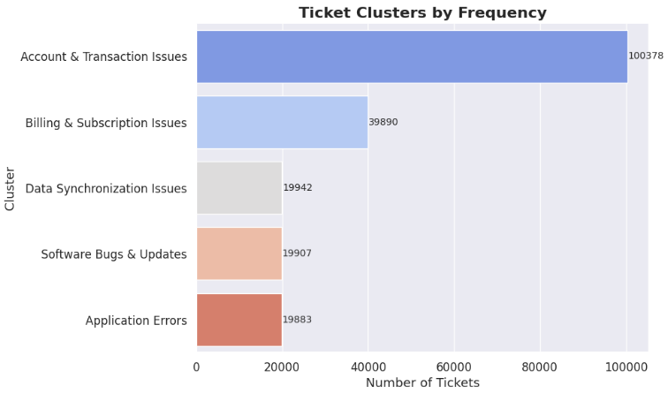
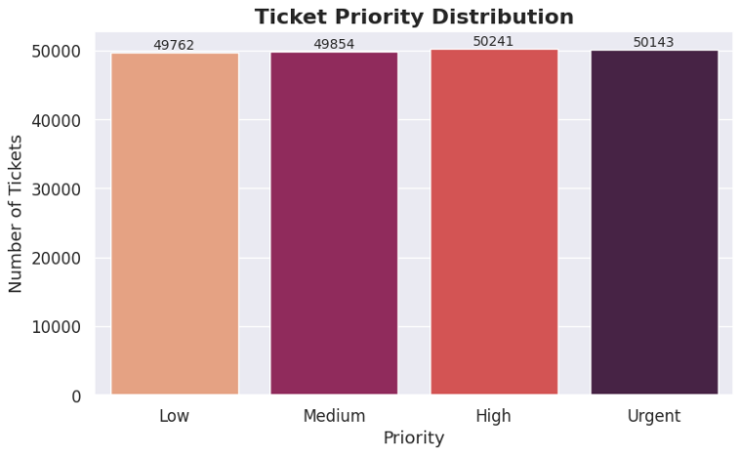
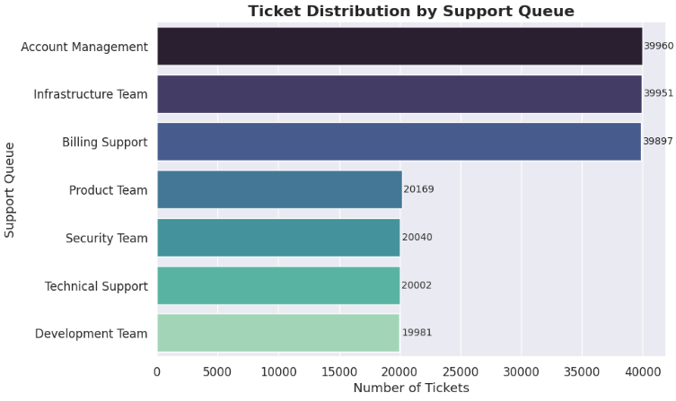
Exploratory Visualization II
Cluster Distribution
Priority Distribution
Queue Distribution
Account & Transaction Issues is the dominant cluster with 100,378 tickets, highlighting authentication, payment, and account management as major support challenges.
Ticket priorities are nearly evenly distributed — all priority levels require consistent operational attention.
Account Management, Infrastructure Team, and Billing Support process the highest ticket volumes — key areas for staffing and optimization.

Slide 5
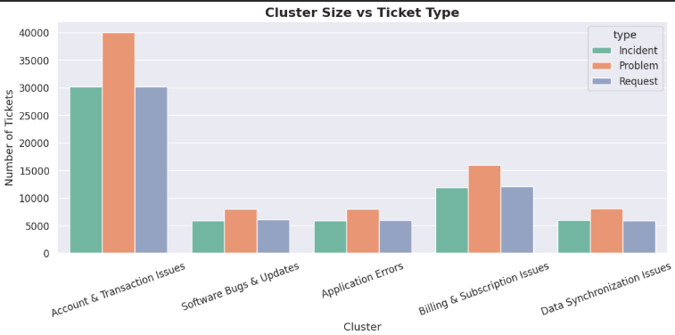
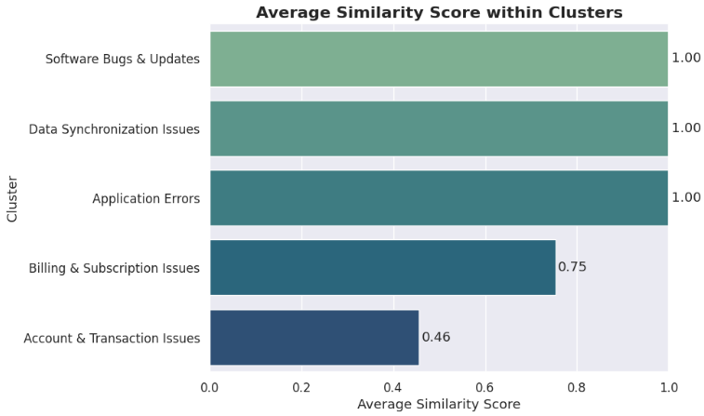
Similarity & Cluster Analysis
Cluster Size vs Ticket Type
Account & Transaction Issues dominate across Incident, Request, and Problem ticket types. Improvements in this area could reduce the overall support workload.
Similarity Score
Three clusters achieved similarity scores close to 1.0, indicating strong internal consistency. Account & Transaction Issues (0.46) contains more diverse ticket types, suggesting opportunities for finer-grained clustering.

Slide 6
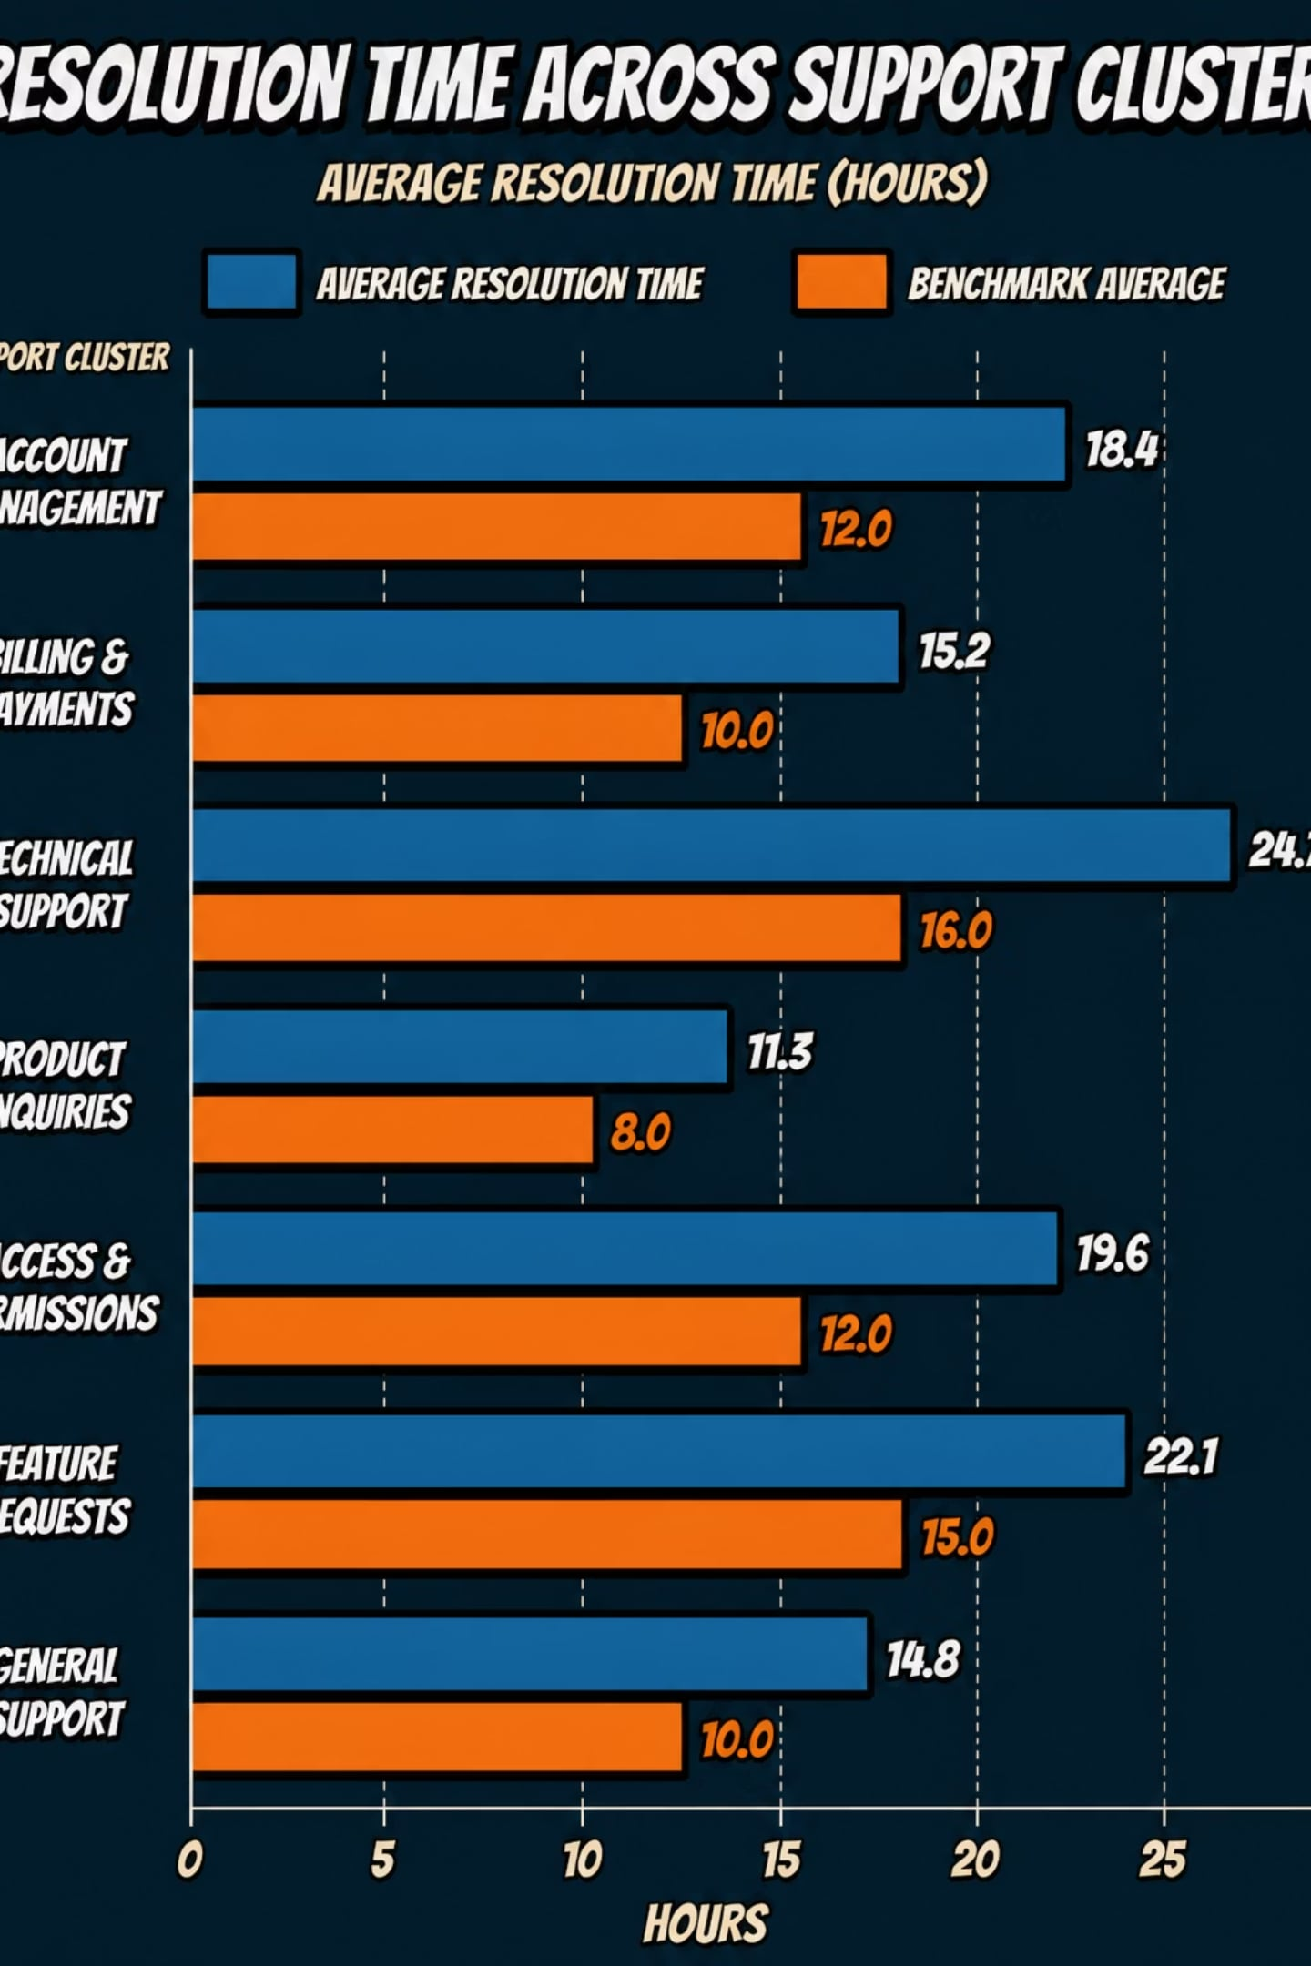
Performance Gap Analysis
Consistent Resolution
No Significant Delays
Resolution times are relatively consistent across all clusters.
No cluster experiences significantly longer resolution times than others.
Outliers Present
A few outliers indicate tickets requiring extended support effort.

Slide 7
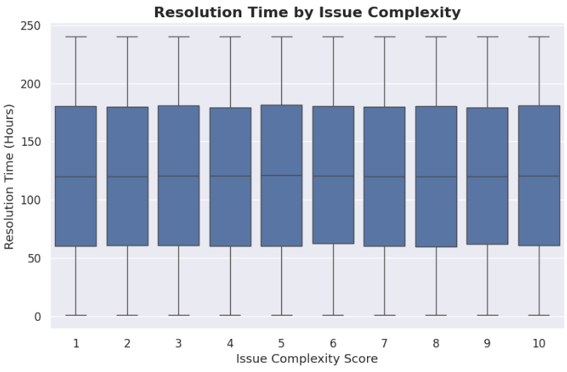
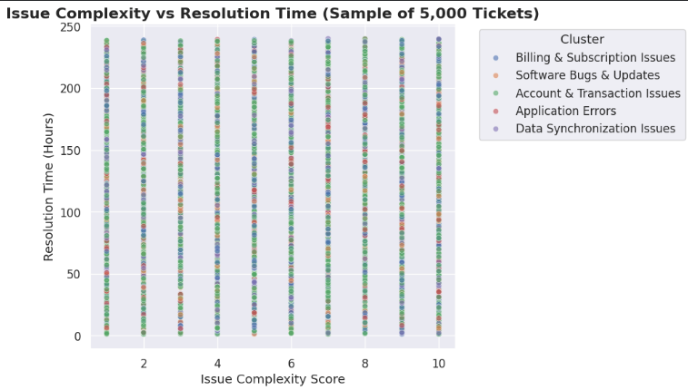
Issue Complexity Analysis
Resolution Time by Complexity
Resolution times remain relatively stable across complexity levels, indicating consistent handling of both simple and complex issues.
Complexity vs Resolution Time
No strong linear relationship between complexity and resolution time. Resolution performance appears to depend on additional factors such as support queue, agent expertise, and SLA requirements.

Slide 8
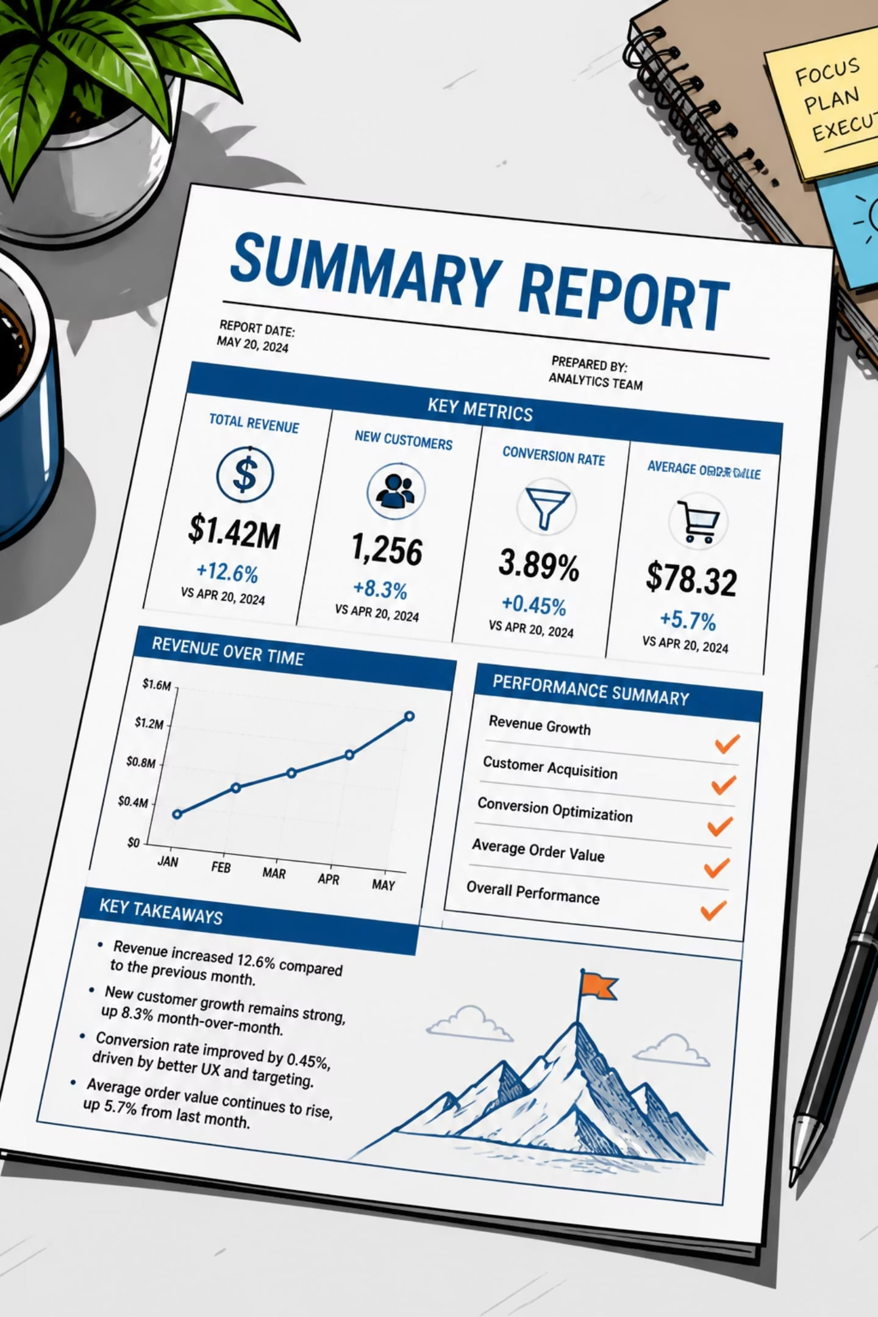



Key Findings
Dataset & Features
Processed 200,000 support tickets. Engineered Queue, Cluster_ID, Cluster_Name, Similarity_Score, and Similarity_Level features.
Clustering
Applied TF-IDF and MiniBatch K-Means to generate 5 meaningful ticket clusters.
Top Cluster
Account & Transaction Issues is the largest cluster (100,378 tickets). Account Management, Infrastructure Team, and Billing Support handle the highest workloads.
Validation
Most clusters exhibit high similarity, validating the clustering approach. Resolution performance remains stable across clusters with no significant delays observed.

